Slide 1
ECSC 325.200
Web Server Administration
Spring 2025 – Week 12-1 – April 1st, 2025
Network and File System Reviews, Data Centers
Prof. Jason Patalon

Slide 2

Objectives
Cloud Review
DevOps Review
Data Center Review
Parted and FDisk
Show & Tell
Notes:
Easy may be relative…

Slide 3

Weekly Info
“Go as far as you can see, and you will see further.” - Zig Ziglar
Attendance
Assignment 11 due April 2nd
Assignment 12 due April 9th
Assignment 13 due April 16th
Good of the class
  Final Exam
    300 Points
      Hands-on: 40 points (similar to many assignments)
      Short/long answer: 260 points (similar to midterm)
    Tuesday April 29th, 2025
    5:00PM – 7:00PM
Stuxnet Virus Video?!
  https://www.youtube.com/watch?v=J07N1KXOyfk
    10 Minute runtime
Professor online most of the days (checking email)
  8:00 AM to 8:00 PM
  Except lunch…
Notes:
Lunch sometime between 12:00 - 2:00 pm

Slide 4

Recap and Review
The next few weeks…
  Security and Authentication
  Firewalls and Filters
  Network Services
  Monitoring & Performance Tuning
  Cloud
  Final Exam!
Corrections, updates, etc.
  Update to our configs – coming later!
Questions from previous classes?
  Feel free to ask during class, after class, email, office hours…
Etcetera

Slide 5

Objectives
Administrative
Monitoring Review
Multi-homed Networking Review
File Systems Review
Cloud Review
DevOps Review
Data Center Review
Parted and FDisk
Show & Tell

Slide 6
Semester Grades Review
Grades are assessed according to the following breakdown:
Description Percentage Total Points Graded points Remaining Points
Midterm Exam 21.42% 300 300 0
Final Exam 21.42% 300 0 300
Attendance (20-28) 6.00% 84 57 27
Assignments (11-14) 51.14% 716 426 290
Total 100.0% 1400 783 617
  Assignment 14 – 140 Points, more detail & input expected!
  Final – 300 Points – Hands on configuration portion, mostly 2nd half content
  Not including today’s attendance points
AWS Bonus Assignment 50 points?

Slide 7

Assignment 10 Review
Add a permanent NFS mount with the default mount options, no backups, and no disk checks.
Week 9
  Install NFS Client tools (should already be installed)
      dnf -y install nfs-utils
  Create the local folder to mount at:
      mkdir /share
  Add network mount to filesystem configuration file /etc/fstab
      147.64.243.110:/share /share nfs bg,rw,sync,hard,intr 0 0
  Mount any missing filesystems from /etc/fstab file
      systemctl daemon-reload
      mount -a
  Check that filesystem has been mounted
      df -h /share
        147.64.243.110:/share 16G 1.8G 14G 12% /share

Slide 8
Assignment 10 Review
Install the vsftpd server software, the ftp client software, and configure the vsftpd service
Week 9
  Install vsftpd server and ftp client
      dnf install vsftpd ftp -y
  Edit vsftpd configuration file: /etc/vsftpd/vsftpd.conf
      anonymous_enable=YES
      anon_upload_enable=YES
      anon_root=/var/ftp
      anon_umask=022
  Set permissions on anonymous upload directory
      chown -R root:ftp /var/ftp/pub
      chmod -R ug+rwX,o+rX,o-w /var/ftp/pub
      ls -lah /var/ftp
  Start vsftpd service and enable to run on system startup
      systemctl enable vsftpd.service && systemctl start vsftpd.service

Slide 9
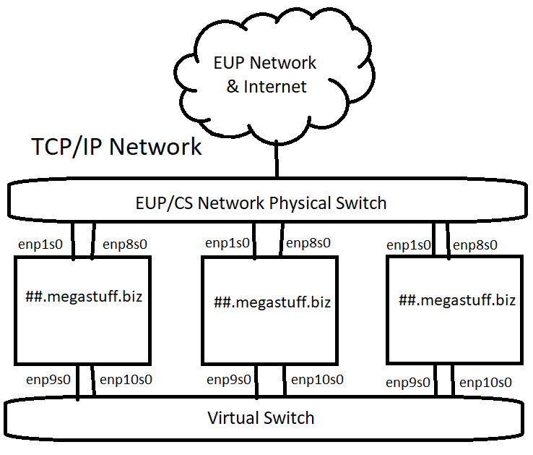
Multiple Network Configurations
Our ##.Megastuff.biz servers have network interfaces
on two different networks!
  Device eth0 & eth1 – EUPCS Network
    enp0s3 & enp0s8 in picture
  Device eth2 & eth3
    enp0s9 & enp0s10 in picture
Our virtual network only exists within the hypervisor!
  Only VM’s in this cluster can access the virtual switch!
We can use this separate virtual network for
security, administration, backup, or other reasons!
This is network virtualization at the hypervisor layer
Logical vs. Physical
Multihoming – Connecting a device to more than one network

Slide 10
Virtual Network Configurations
We can further virtualize our network traffic using
Virtual Local Area Networks (VLANs)
While all network traffic flows over the same physical
links, VLAN traffic over the virtual switch is tagged
within the infrastructure as a specific network
Different switch ports can be set for different VLANs
A different logical network using existing physical cables
This is virtualization at the interface or guest layer
  The guest can optionally do VLAN tagging
  The switch can force VLAN tagging on specific ports & traffic
Standardize, make repeatable

Slide 11
File Systems
File systems provide a method of organizing data on a storage media.
The basic building block of most Linux file systems is the i-node
  The i-node is a control structure that either points to data or other i-nodes
  The i-node contains info such as ownership, permissions, access/edit times, and similar.
    It does not provide the file name however!
  Data is broken into blocks
    The smallest amount of addressable data on a device
    A block may contain an entire file, or only part of the file, depending on sizes
    The block size can be specified when creating the file system, such as 1KB
    Blocks are grouped together into block groups
      Block groups contain a copy of the superblock, a descriptor table, the block bitmap,
      an i-node table, and data blocks
  Superblocks are the first piece of data read from a disk
    A small piece of very important information, they contain the disk geometry,
    amount of available free space, and the location of the first i-node

Slide 12
File Systems
Some file systems use Extents instead of i-nodes
  An extent is a means of representing contiguous physical blocks
  Provides information about the next range of blocks
  Instead of pointing to each individual block, the extent
  says the next X blocks belong to a specific data file.
Defragmentation is when these data blocks are spread
out on the disk, with other data blocks in between.
  Traditionally defragmentation was done offline
    Nothing can access the disk, interrupting the defrag process
  Online defragmentation became possible with newer file systems
    Some filesystems allow for defragmentation of individual files
Different file systems have different features
  Online defrag, online disk checking, encryption, RAID functions,
  compression, large disk sizes, various block sizes, deduplicaton…

Slide 13
File Systems
We use the mount command to mount a file system
  We also use the umount command to unmount a system
We define our boot-time mounts in the /etc/fstab file
  Ex: /dev/mapper/centos_ds1019vm-root / xfs defaults 0 0
We can use the fsck tool to diagnose and repair file system issues
  File System Check (fsck) – Similar to Check Disk in Windows
    Can run automatically as scheduled
    Often required on boot after so many days or number of mounts
  Linux typically automatically can repair issues by itself
    Some times critical data may be lost, and the system may not be able to boot
      While you may be able to recover from this, it is often a futile effort
    If fsck finds file segments it doesn’t know what to do with, they will end up in
    the “lost+found” directory of that file system (if supported by the file system)
      Separate mount points would have their own “lost+found” directories

Slide 14

Intro to Amazon Web Services
Started with S3 (Simple Storage services), expanded to multiple other services
Compute – Various different operating system
  Create your own custom OS images to deploy from
  Virtual Machines!
  Auto Scaling Groups
  Load Balancers
Storage – Multiple types of data storage
  SSD or traditional disks for block storage
  Object storage for video/image files, etc
Database – Relational databases or others (NoSQL)
  Create your own databases or database management systems
  Backups, availability, etc.

Slide 15
Intro to Amazon Web Services
Networking – Create your own logically separate network
  Virtual Private Cloud (VPC) – Separate routes, CIDR masks, subnets, and more
    Encrypted connections possible as a service
  Route 53 – Cloud DNS Management
Many more services!
  Email, messaging, analytics, data analysis, security, utilization, deployment services, mobile services…
Multiple ways to manage your services
  AWS Management GUI Console
  AWS Command Line Interface
  AWS API HTTP Calls
  Various SDK’s for multiple programming languages
  IDE toolkits for Eclipse and Visual Studio

Slide 16
Intro to Amazon Web Services
AWS Regions
  Fairly independent collections of data centers
  within a specific geographic area
    US East, N Virginia, us-east-1
    US West, Oregon, us-west-2
    Asia Pacific, Tokyo, ap-northeast-1
  https://www.cloudping.info/
Availability Zones
  A specific zone within an AWS Region
  Separate datacenters
  Low latency connections between AZ’s
  Provides for fault-tolerant designs
    If an AZ goes offline, you can run on another AZ in that region
Geolocation!

Slide 17
Intro to Amazon Web Services
Benefits and use cases for AWS services
  Faster time to deployment of new applications
  Cloud backup and storage archival options
  Disaster recovery strategies with AWS
    Cold, warm, and hot sites
  Edge locations
    Content delivery networks
    Keep the data cached closer to the end user
  Computationally intense tasks
    You’re only charged while your task runs – typically per hour
      Rate changes depending on what the type/speed/config of VM
    100 Hours on 10 VM’s = 1 hour on 1,000 VM’s
    Save money, especially if tasks are infrequent

Slide 18
Intro to Amazon Web Services
Elastic Compute Cloud (EC2)
  Most common compute service that Amazon offers
  Deploy virtual machines
  Amazon Machine Images (AMI’s)
    Template of pre-configured EC2 instances
    Can include a base OS and additional applications
    Customized AMI’s and
  Instance Types
    Size of instance: CPU, RAM, Disk, Network, etc.
    Categorized into different families – different types of hardware
      Storage optimized, compute optimized, memory optimized,
      GPU, general use, combination, etc.

Slide 19
DevOPS
DevOPS – A set of practices that automates the processes between software development and IT teams
  Allows for rapid building, testing, and deployment
    Can deploy new versions of software more often
    Create automated testing and review scenarios
  Manage infrastructure as code
    Git, branching, pull, merge, versioning…
  Key items of DevOPS:
    Culture – A shift from individual silos to cross-team collaboration
    Automation – Remove the possibility of human error, make things repeatable
    Lean – Eliminate low-value activities and move quickly, agility, fail fast
    Measurement – Show increases in efficiency of new processes, identify areas of improvement
    Sharing – Share responsibility between Dev and Ops to grow the teams and increase success rates

Slide 20
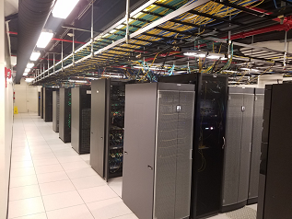
Data Center Quick Info
Rack mountable equipment
  Specific, measurable, known
Extensive redundancy
  Redundant power, cooling, networks, other devices
Power Distribution Units (PDU’s)
  Can monitor power draw (amperage)
  Some are network accessible
Raised floor design
  Power feeds under floor
  Cooling through floor
Overhead cable trays
  Storage networks or TCP/IP networks

Slide 21


Slide 22
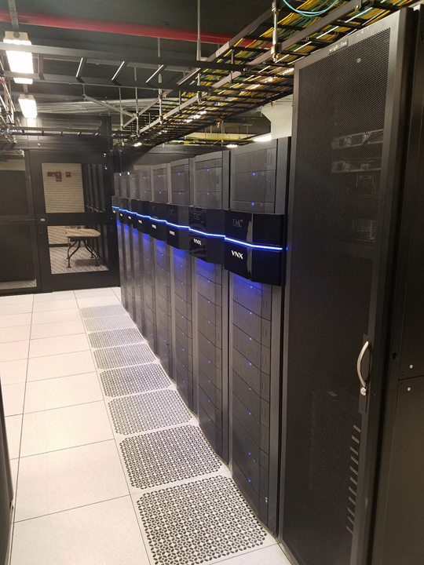

Slide 23
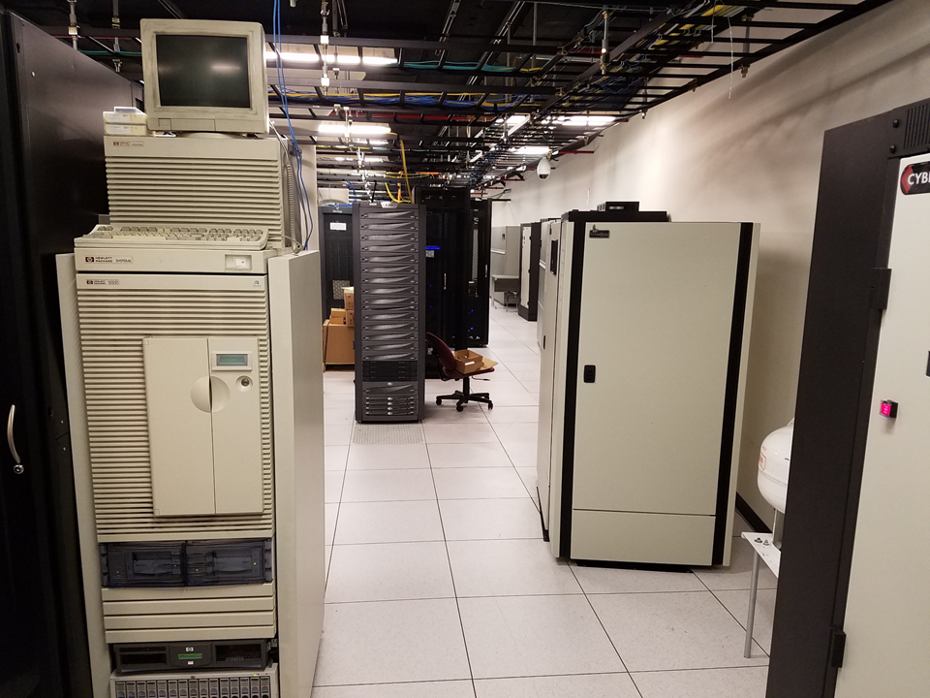

Slide 24
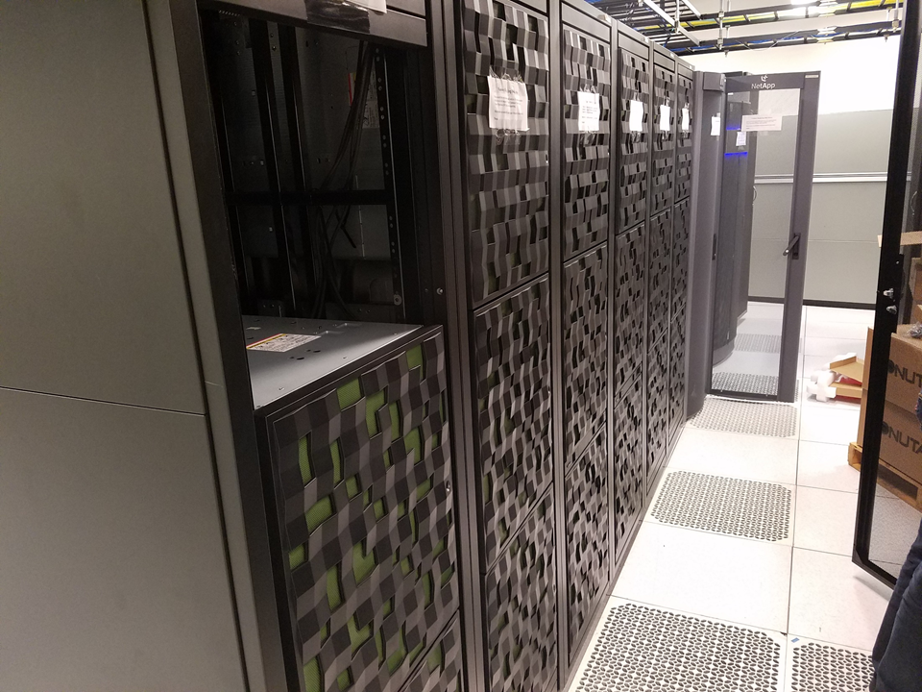

Slide 25
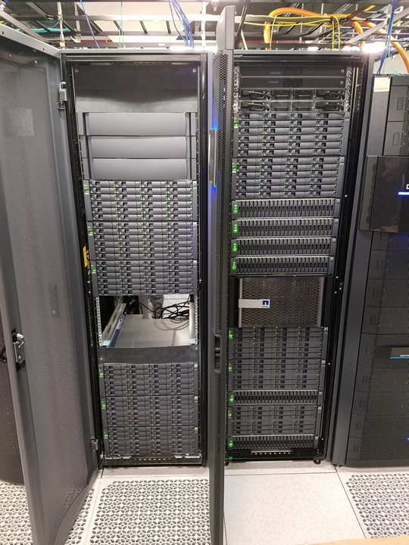

Slide 26
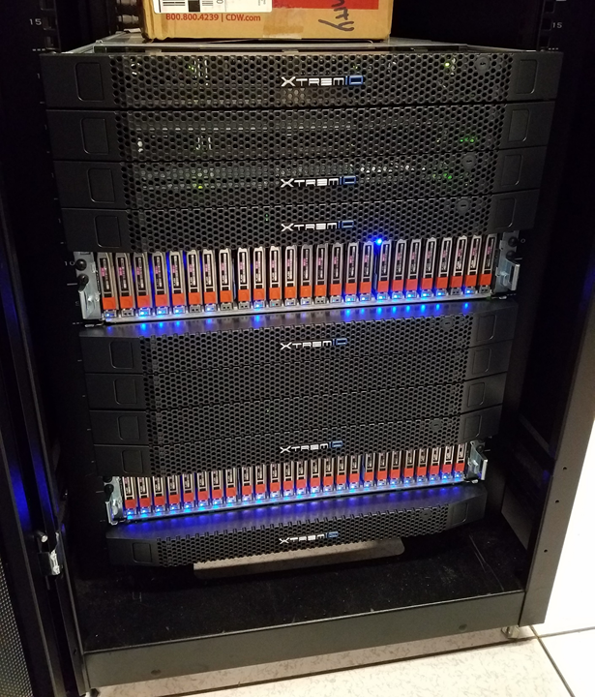

Slide 27
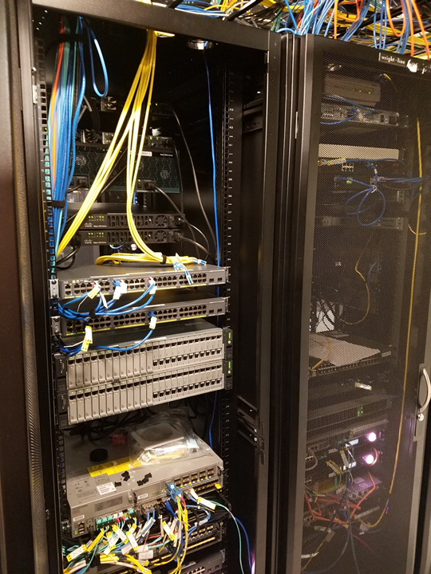

Slide 28
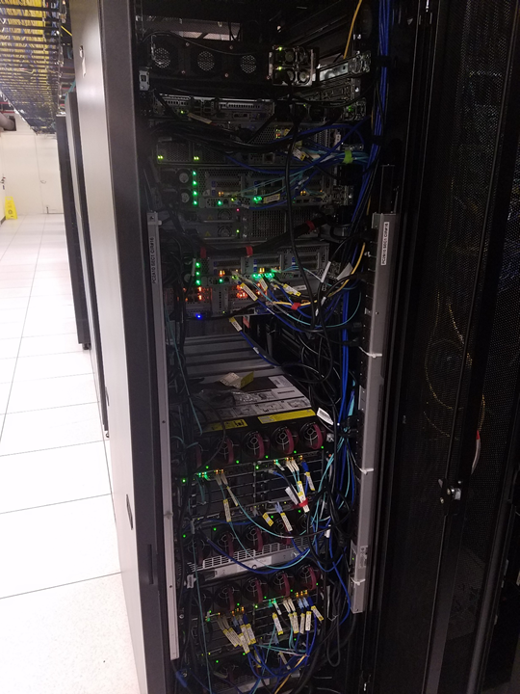

Slide 29
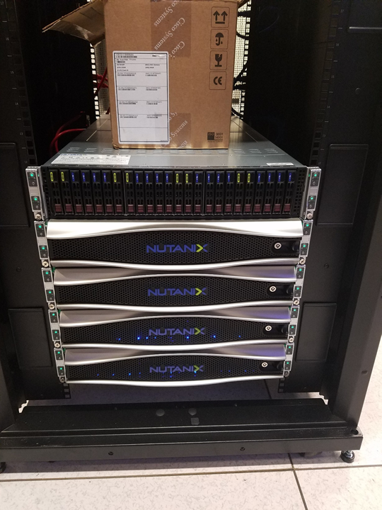

Slide 30
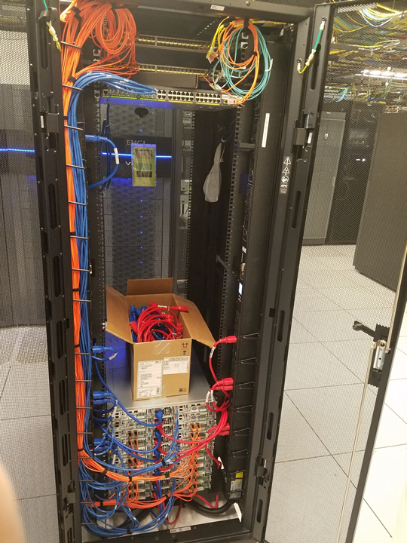

Slide 31
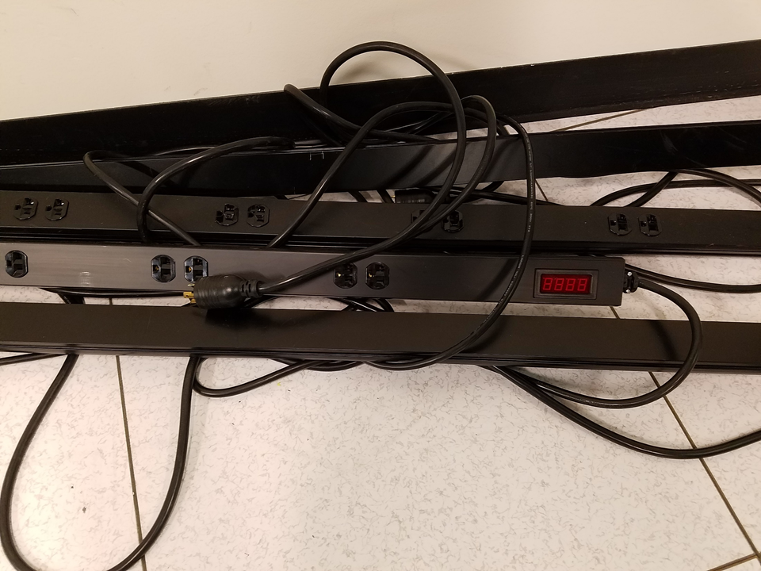

Slide 32
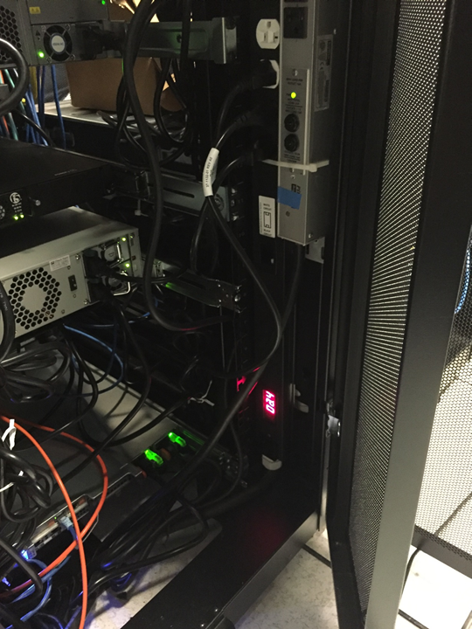

Slide 33
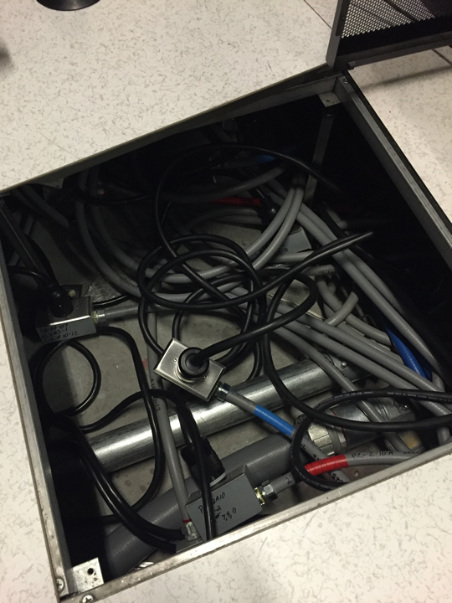

Slide 34
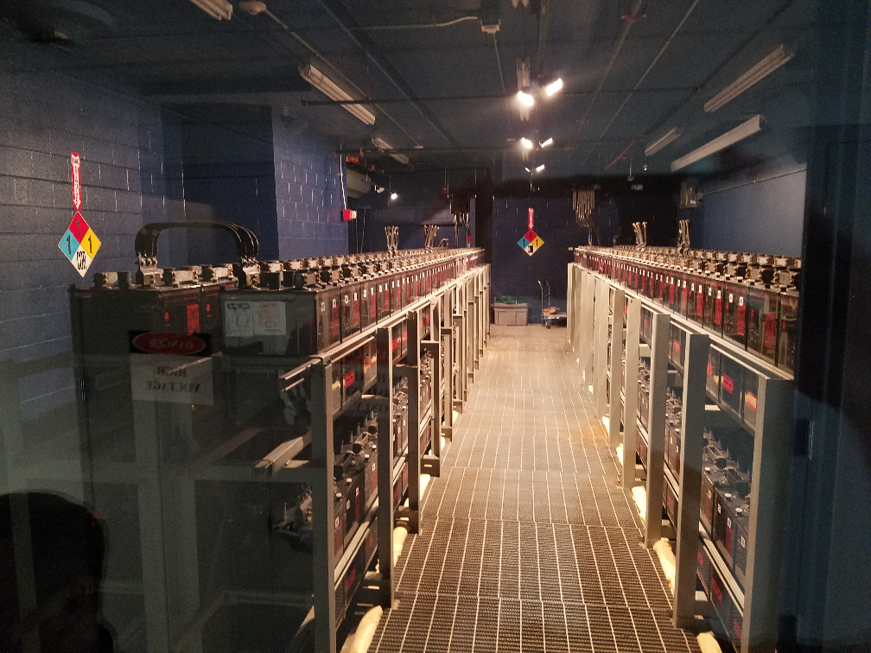

Slide 35
Data Center Quick Info
Data Storage Frames!
Tons of hard drives providing raw storage
Controller PC manages devices
RAID
Highly Available
Ultra Fast Fiber Channel Connectivity
Horizontal drives = Traditional Spinning Hard Disk Drive (HDD)
Vertical drives = Solid State Storage (SSD)

Slide 36
Data Center Quick Info
Under the floor!
Power and air handling
  Cold air is pumped into the floor
  Grated floor tiles allow cool air up in the proper places
Two different power feeds
  Red power feed – “Side A”
  Blue power feed – “Side B”
  Make sure to follow power separation into cabinets!
    Its pointless to have separate power feeds if you don’t use them appropriately!
  May be separate feeds from two different utility providers,
  or separate feeds from the same utility provider

Slide 37
Data Center Quick Info
Battery Backup Power!
  Banks of lead-acid batteries
  These batteries give off toxic fumes…
    There is an exhaust fan in the back corner of the room
    There is also a temperature control unit back there
  Wired together to provide the correct voltage/amperage
    Series vs. parallel wiring
  Batteries provide instant power, preventing interruptions
  when utility power is lost
  Battery backup is only intended for a short time (< 1 hour)
  A generator is intended to provide extended power
  supply during a utility power outage
Area for improvement? New battery technology?

Slide 38
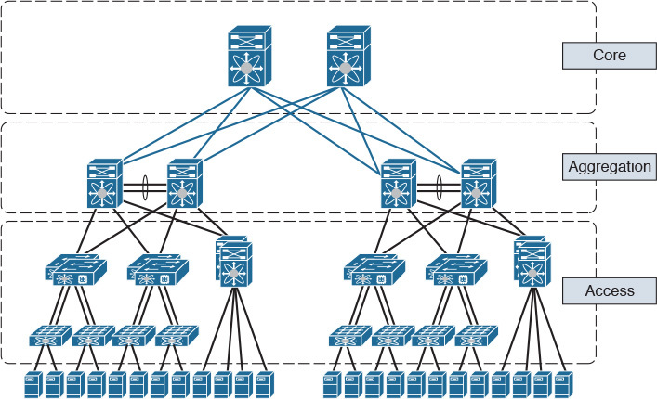
Data Center Infrastructure
Storage
  Physical Disk Storage
    Local server storage
    Storage Area Network (SAN)
    Network Attached Storage (NAS)
Networking
  Three-Tier Design
    Core Switches
    Aggregation or Distrubution Switches
    Access or Top of Rack Switches (multiple layers)
Compute
  Various form factors
    Rack mount, blades, desktop chassis
  RAM/CPU/Motherboard – Sometimes storage

Slide 39
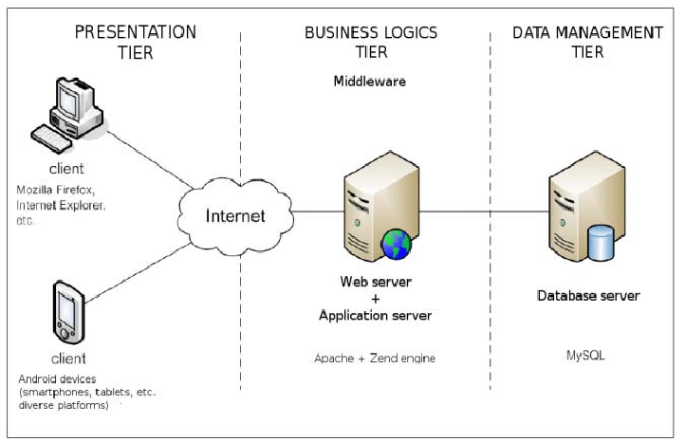
3-Tier Architecture
A Client-Server software architecture pattern
Clients interact with the presentation tier
  Also called the client tier
  Web browser, mobile device interface, or others (fat client)
Logic Tier coordinates the application and commands
  Programming and website logic
  Website server
Data tier stores and organizes data
  Databases
  SQL commands and similar
Middleware may be in place connecting between layers

Slide 40

Hyper-Converged Infrastructure
Virtualizes the aspects of a conventional hardware defined data center system
  Virtualized computing (VM’s), Virtual SAN, Virtual Networking
  Often times run on commodity (off the shelf) hardware
    Decreased costs, can be easier to obtain, can be a lesser quality…
  Software defined IT Infrastructure
    Virtualize everything, script everything, automate everything
    Easily repeatable, easily auditable, easily maintained
  How far can you virtualize?
  How much can you automate?
  Leads to different data center methodology!
    Standardize hardware components
    Virtualize everything
    Script the entire deployment of your infrastructure
      Then automate your middleware and app deployments!

Slide 41
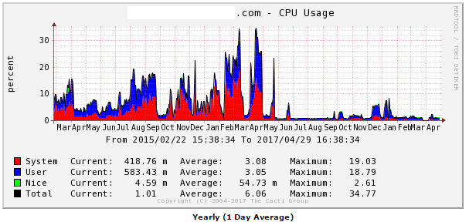
Monitoring Operating Systems
Splunk
  Log file aggregation tool - Organize many different log files into a single searchable interface
    Multiple logs from multiple systems!
  Correlate information between different logs/systems/etc.
Cacti
  Monitor network, CPU, disk space, etc.
  Long-term system monitoring
  Example graph to right →
Naigos
  Similar to Cacti
  Monitor system resources
Netdata
  Real-time short-term system monitoring
Nimbus

Slide 42
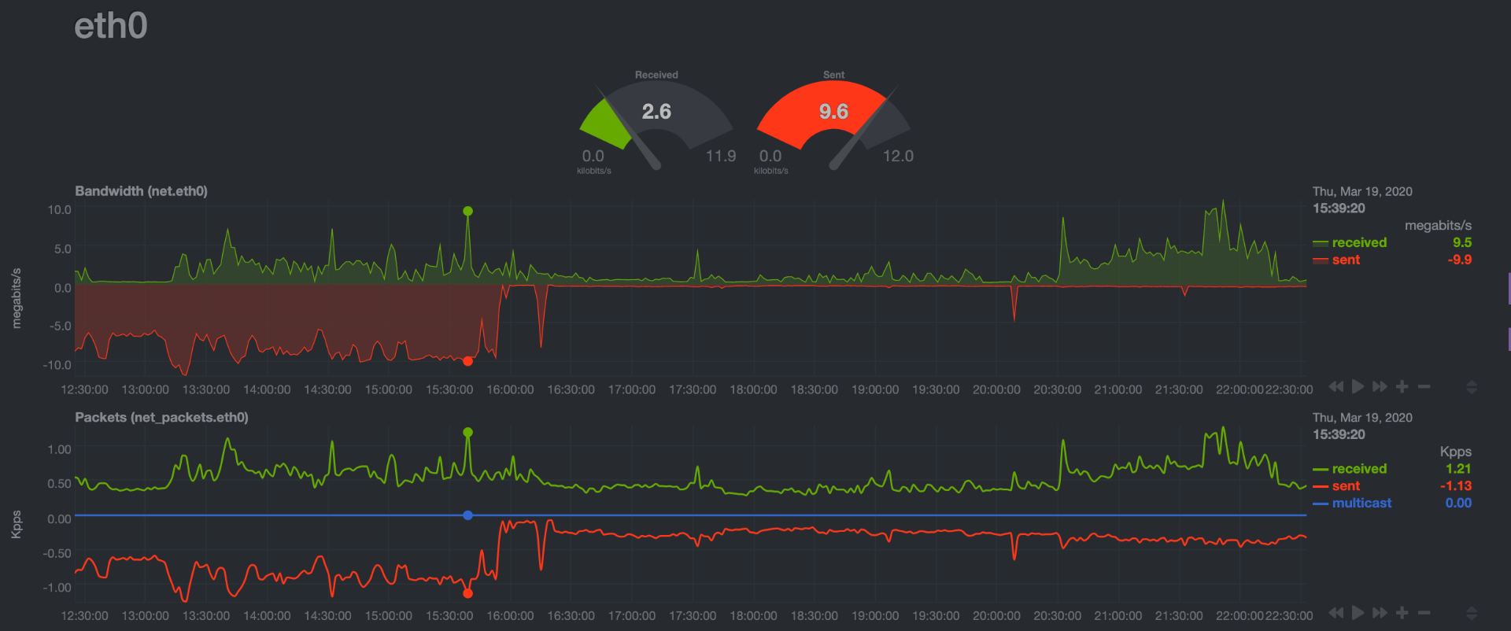
System Analysis and Troubleshooting
Upon a random look at graphs on my system, I notice the following…
  Outbound traffic on eth0 is pretty high! Approx 9.6 MBps outbound constantly…
    Eth0 is the WAN (internet) interface
  Is this normal usage?
  Lets take a look at
  our historical graph…

Slide 43
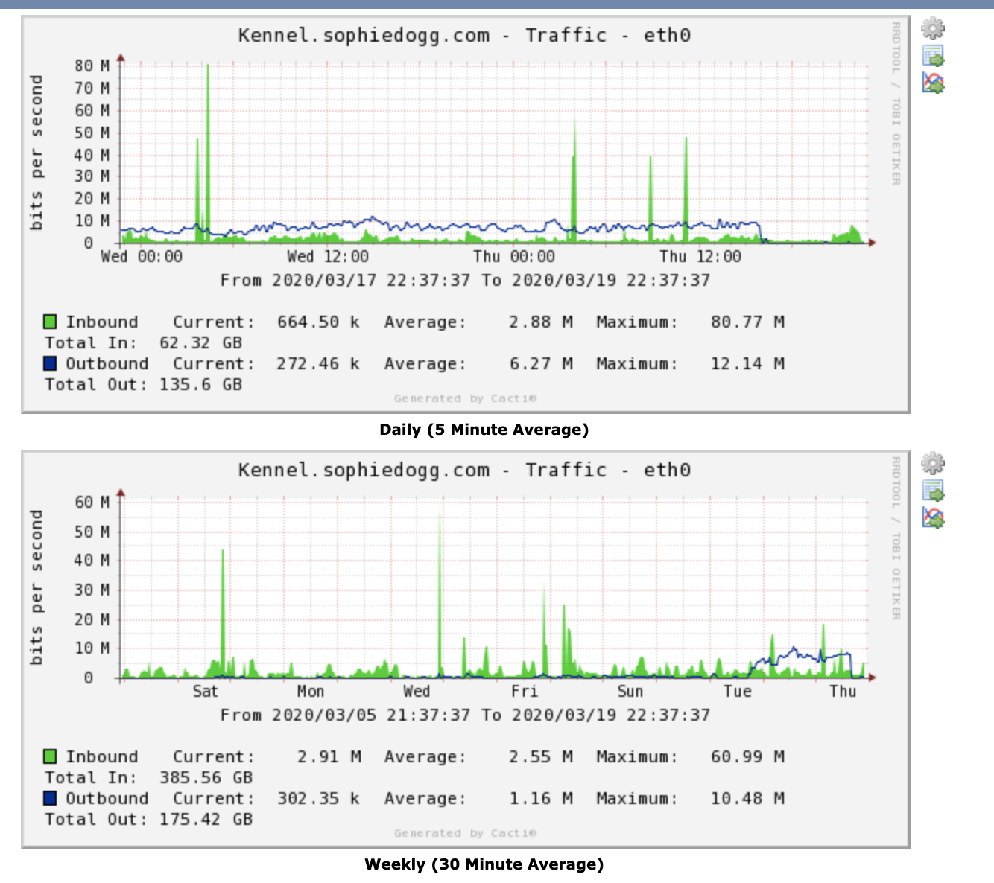
System Analysis and Troubleshooting
Upon a random look at graphs on my system, I notice the following…
  Outbound traffic on eth0 is pretty high!
    Eth0 is the WAN (internet) interface
  Is this normal usage?
  Lets take a look at
  our historical graph…
  That looks like it has
  been sending data
  for almost a day…
    Probably not normal
  Let’s investigate further…

Slide 44
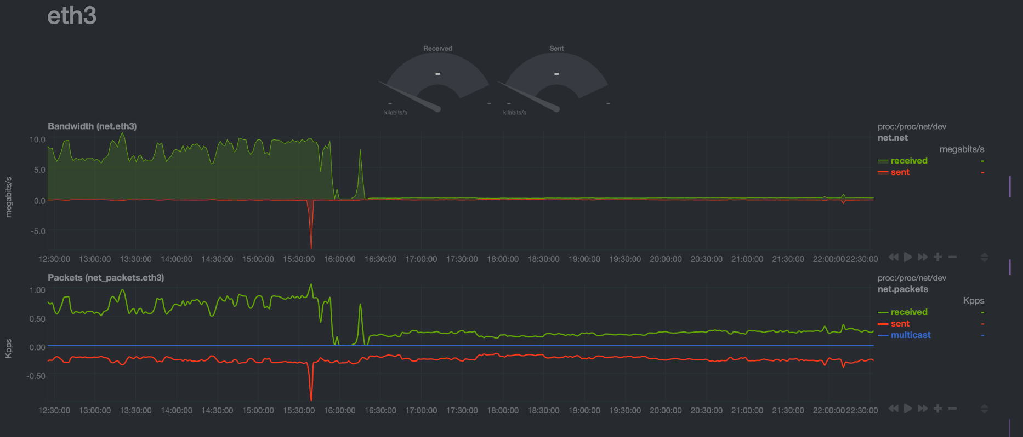
System Analysis and Troubleshooting
Upon a random look at graphs on my system, I notice the following…
  Outbound traffic on eth0 is pretty high!
    Eth0 is the WAN (internet) interface
  Is this normal usage?
  Lets take a look at
  our historical graph…
  That looks like it has
  been sending data
  for almost a day…
    Probably not normal
  Let’s investigate further…
  Well, that’s a similiar
  pattern on eth3 (NAS)…

Slide 45
System Analysis and Troubleshooting
Upon a random look at graphs on my system, I notice the following…
  Outbound traffic on eth0 is pretty high!
    Eth0 is the WAN (internet) interface
  Is this normal usage?
  Lets take a look at
  our historical graph…
  That looks like it has
  been sending data
  for almost a day…
    Probably not normal
  Let’s investigate further…
  Well, that’s a similiar
  pattern on eth3 (NAS)…
  Gotta go read logs…

Slide 46
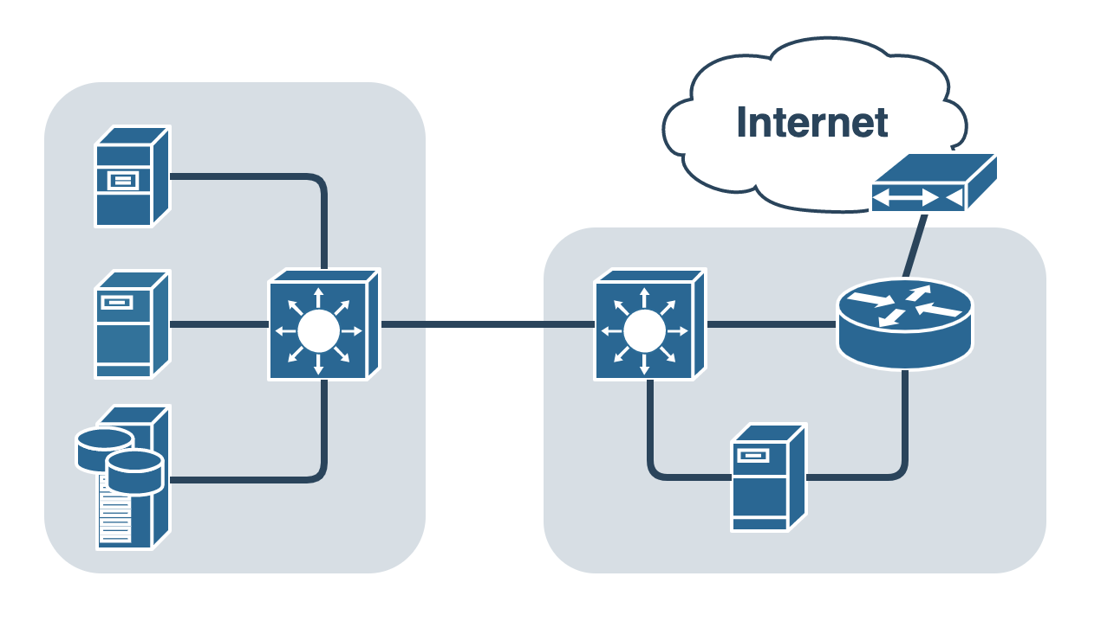
System Analysis and Troubleshooting
Two physical devices
  Physical Server
    VM Host
    SSH Server
    VPN Server
    File Server
    Lots of disks and network cards
    DNS, DHCP, NTP, more…
  NAS
    5 x 10TB disks
    Raid 5 array, 1 hot spare
    27TB available, 9TB in use
    VM Host
      Put services in separate VMs!
      DNS, DHCP, NTP, more…
DS1019+ NAS
Physical Server

Slide 47
System Analysis and Troubleshooting
Turns out this was a DNS redirection DDOS attack!
  I had recently moved my DNS services to a new VM running on my NAS device (on eth3)
  I previously would forward all DNS requests to my new internal DNS server
    This DNS server performed authoritative responses for my personal subdomains
    This DNS server also performed non-authoritative recursive DNS resolution for clients on my local network
    The forwarding rules I put in place for DNS forwarding to the internal VM perform IP Masquerading (NAT) on incoming addresses
    To my internal DNS server, the forwarded requests from the internet appear to come from the router’s local IP address!
Can you guess what happens next?!
DS1019+ NAS
Physical Server

Slide 48
System Analysis and Troubleshooting
Turns out this was a DNS redirection DDOS attack!
  I had recently moved my DNS services to a new VM running on my NAS device (on eth3)
  I previously would forward all DNS requests to my new internal DNS server
    This DNS server performed authoritative responses for my personal subdomains
    This DNS server also performed non-authoritative recursive DNS resolution for clients on my local network
    The forwarding rules I put in place for DNS forwarding to the internal VM perform IP Masquerading (NAT) on incoming addresses
    To my internal DNS server, the forwarded requests from the internet appear to come from the router’s local IP address!
My private internal server became an open DNS resolver!
https://www.cloudflare.com/learning/ddos/dns-amplification-ddos-attack/

Slide 49

IPTables Examples - WWW
Allow any TCP packets coming in on port 80
  iptables -A INPUT -p tcp --dport 80 -j ACCEPT
Restrict TCP traffic coming in on port 80 to unprivileged source ports
  iptables -A INPUT -p tcp --dport 80 --sport 1024:65535 -j ACCEPT
Restrict inbound port 80 TCP traffic to specific IP and network interface
  iptables -A INPUT -i eth0 -p tcp -d 192.168.1.10 --sport 1024:65535 --dport 80 -j ACCEPT
Allow outbound traffic to TCP port 80 from our server
  iptables -A OUTPUT -p tcp --dport 80 -j ACCEPT
Allow outbound traffic to UDP port 443 from our server
  iptables -A OUTPUT -p udp --dport 443 -j ACCEPT

Slide 50
IPTables Examples - SSH
SSH uses port TCP 22
Input rules for SSH Servers:
  iptables -A INPUT -p tcp --dport 22 -j ACCEPT
Output rules for SSH Connections:
  iptables -A OUTPUT -p tcp --dport 22 -j ACCEPT
Rules can potentially be more complex/restrictive
  iptables -A OUTPUT -o eth0 -p tcp -s 192.186.0.1 --dport 22 --sport 1024:65535 -j ACCEPT

Slide 51
IPTables Example – Filter Table/Input Chain
*filter
:INPUT DROP [0:0]
:FORWARD DROP [0:0]
:OUTPUT ACCEPT [1:71]
-A INPUT -m state --state RELATED,ESTABLISHED -j ACCEPT
-A INPUT -i lo -j ACCEPT
-A INPUT -i br0 -p udp -m udp --dport 67 -j ACCEPT
-A INPUT -s 66.220.2.74/32 -i eth0 -p icmp -m icmp --icmp-type 8 -m limit --limit 1/sec -j ACCEPT
-A INPUT -j fail2ban
-A INPUT -p udp -m udp --dport 53 -j ACCEPT
-A INPUT -p tcp -m tcp -m multiport --dports 53,1194,50505 -j ACCEPT
-A INPUT -s 10.11.187.0/24 -i br0 -p tcp -m tcp -m multiport --dports 19,19999,32400 -j ACCEPT
-A PREROUTING -p udp -m udp --dport 21 -j DNAT --to-destination 10.11.187.31:1194
-A POSTROUTING -s 10.11.186.0/23 -o eth0 -j MASQUERADE
-A POSTROUTING -d 10.11.187.31/32 -p tcp -m tcp --dport 1194 -j SNAT --to-source 10.11.187.1
-A POSTROUTING -d 10.11.187.31/32 -p udp -m udp --dport 1194 -j SNAT --to-source 10.11.187.1
COMMIT
RHEL6/CentOS6 - /etc/sysconfig/iptables

Slide 52
Firewall Configurations
FirewallD
  Front-end controller for iptables, used to implement persistent network traffic rules
  Command line and graphical interfaces available
  Rules can be added/removed/modified without interfering with current network traffic
  firewall-cmd command used to modify firewall rules
    firewall-cmd --get-default-zone
      What zone is currently being used by default
      Different zones can be applied to different interfaces
    firewall-cmd --get-active-zones
      What zones are currently active on what interfaces
    firewall-cmd --zone=public --list-all
      What rules are currently configured in the firewall

Slide 53
Firewall Configurations
FirewallD
  Front-end controller for iptables, used to implement persistent network traffic rules
  Command line and graphical interfaces available
  firewall-cmd command used to modify firewall rules
    firewall-cmd --zone=public --add-service=http
      Allow http traffic to the runtime configuration
    firewall-cmd --zone=public --add-service=http --permanent
      Allow http traffic to the permanent configuration
    firewall-cmd --zone=public --add-port=8080/tcp
    firewall-cmd --zone=public --add-port=8080/tcp --permanent
      Allow traffic to TCP port 8080 from any host, runtime and permanent configs
  Rich Rules can be created for more advanced traffic control
    firewall-cmd --zone=public --add-rich-rule 'rule family="ipv4" source address="192.168.0.0/24" port port=12345 protocol=udp accept' --permanent
      The above command is all one line…

Slide 54
Firewall Configurations
FirewallD Configuration
  Start firewalld service and enable on boot
      systemctl start firewalld
      systemctl enable firewalld
  Check our default and active zones and list all rules in our active zone
      firewall-cmd --get-default-zone
      firewall-cmd --get-active-zones
      firewall-cmd --zone=public --list-all
  Add the http and https services to our firewall to allow traffic
    If we try to connect to our websites right now, all web traffic should be blocked!
      firewall-cmd --zone=public --add-service=http
      firewall-cmd --zone=public --add-service=http --permanent
      firewall-cmd --zone=public --add-service=https
      firewall-cmd --zone=public --add-service=https --permanent

Slide 55
Firewall Configurations
FirewallD Configuration
  Add SSH if necessary
      firewall-cmd --zone=public --add-service=ssh
      firewall-cmd --zone=public --add-service=ssh --permanent
      Should already be enabled
  Add a custom rule, allowing TCP traffic on port 55555 from CS subnet
      firewall-cmd --zone=public --add-rich-rule 'rule family="ipv4" source address="147.64.242.0/23" port port=55555 protocol=tcp accept'
      firewall-cmd --zone=public --add-rich-rule 'rule family="ipv4" source address="147.64.242.0/23" port port=55555 protocol=tcp accept' --permanent
    There are two commands listed above (each command is on two lines)
    We could also replace accept with reject, to explicitly reject the traffic!
  Add another rule, using this easier syntax, allowing all sources.
      firewall-cmd --zone=public --add-port=43234/udp
      firewall-cmd --zone=public --add-port=43234/udp --permanent

Slide 56
Firewall Configurations
FirewallD Configuration
  Explicitly REJECT the following traffic
    Perhaps we want to intentionally reject something (speed up timeouts maybe?)
      firewall-cmd --zone=public --add-rich-rule 'rule family="ipv4" source address="147.64.242.0/23" port port=32123 protocol=tcp reject'
  Change our default response to DROP!
    By default, our firewall will respond with a “Blocked” response. We want it to just completely ignore it instead!
      firewall-cmd --zone=public --set-target=DROP --permanent
  Reload our firewall to apply any unapplied configurations, and list what is enabled in our public zone:
    firewall-cmd --reload
      firewall-cmd --zone=public --list-all
  Check out what is happening in all of the zones
      firewall-cmd --list-all-zones

Slide 57

Web Browser SOCKS Proxy Config
Firefox Example
  Extremely easy to set, others more difficult
Open SSH tunnel with dynamic port forwarding to cslab100 using your cslab account
  Ex: ssh –D 55555 jpatalon@cslab100.cs.edinboro.edu
You can also create a shortcut in windows, append to the end:
  Ex: putty.exe –D 55555 jpatalon@cslab100.cs.edinboro.edu
  Download putty, and create a shortcut on your desktop
Log in to your account with your password
Launch Firefox

Slide 58
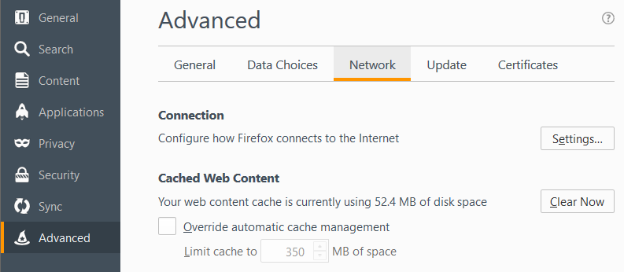
Web Browser SOCKS Proxy Config
Exact steps may differ depending on version
  Options
  Advanced
  Network Tab
  Settings…
Older Firefox
version…

Slide 59
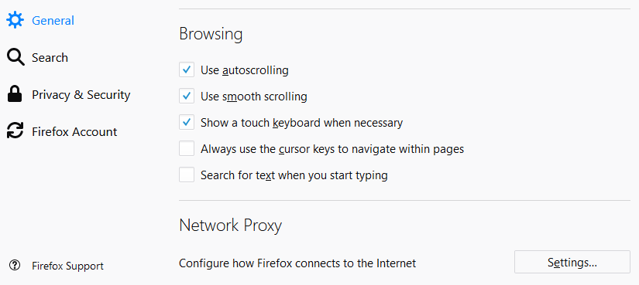
Web Browser SOCKS Proxy Config
Exact steps may differ depending on version
  Options
  General
  Network Proxy
    All the way at the bottom
  Settings…
Firefox
v59.0.1

Slide 60
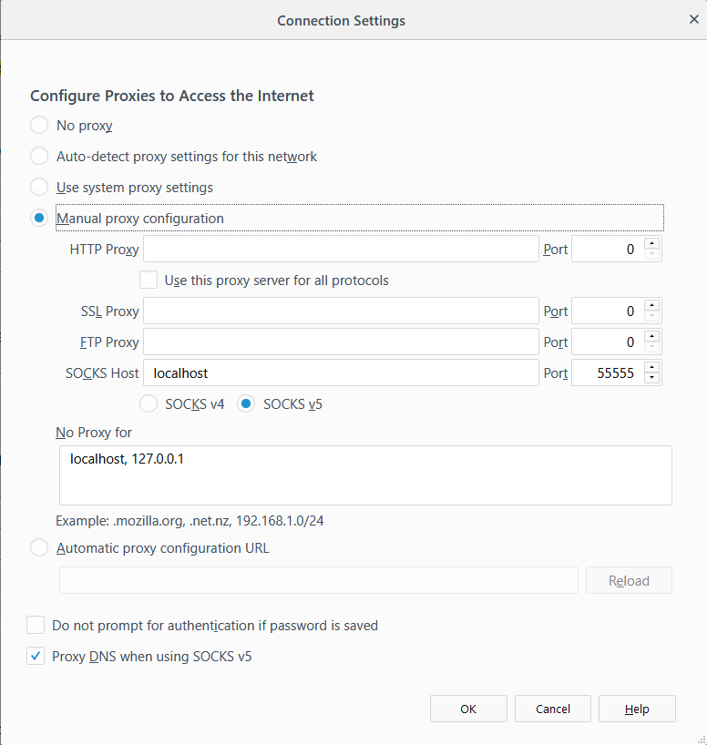
Web Browser SOCKS Proxy Config
Exact steps may differ depending on version
  Options
  Advanced
  Network Tab
  Settings…
    Manual Proxy Configuration
    SOCKS Host: localhost
    Port: 55555
    SOCKS v5
    No proxy for:
      localhost, 127.0.0.1
    Proxy DNS when using SOCKS v5

Slide 61
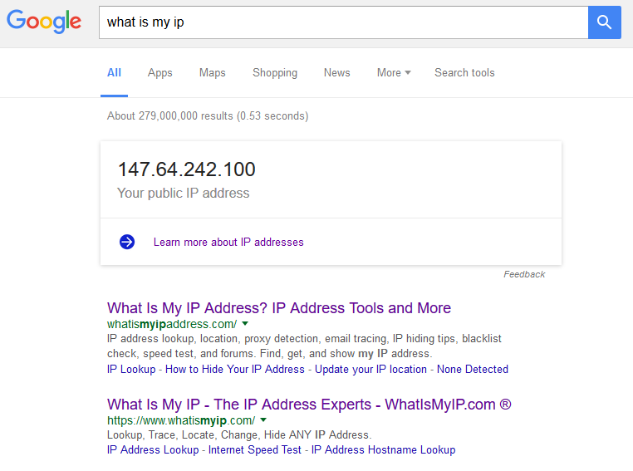
Web Browser SOCKS Proxy Config
Test by opening a web page, and visit a website that will tell you your IP
  http://whatismyip.com
  Type in to google “What is my ip”
  Multiple servers with multiple ports
    Open multiple connections on different ports
    Switch ports to quickly switch proxy endpoint
  Compare to same search in a different browser
  that is not configured for proxying
    Firefox should give a different result than Chrome or
    Interner Explorer, since Firefox is configured to
    use the SSH SOCKS proxy and the other web
    browsers are not.
  You may have to specifically check for
  your IPv4 address!

Slide 62
ECSC 325.200
Web Server Administration
Spring 2025 - Week 12-2 – April 3rd, 2025
Stuff and Things…
Prof. Jason Patalon

Slide 63
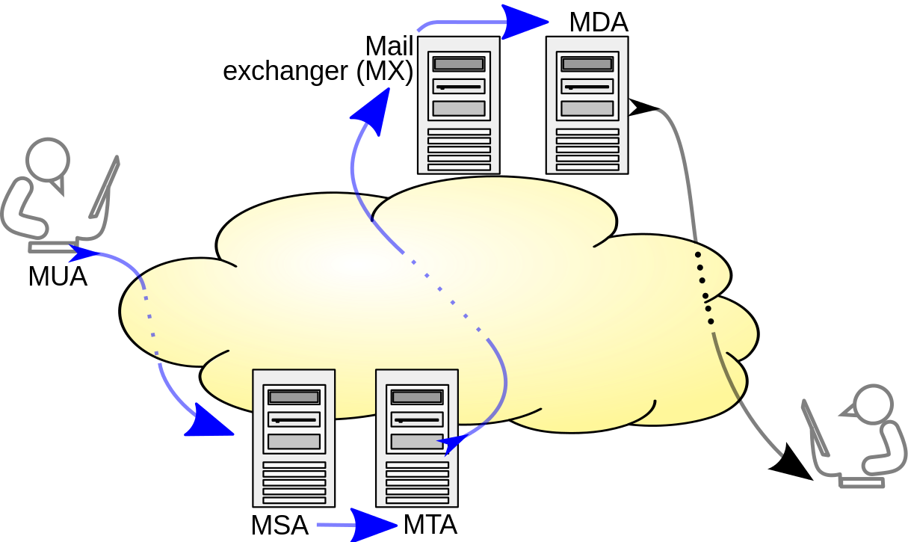
E-Mail System Terminology
MTA – Mail Transfer Agent
  Accepts E-Mail from clients and sends to another MTA for delivery
  Indicated my MX DNS records
  Sendmail, Postfix
MSA – Mail Submission Agent
  Provides address resolution services
  Determines appropriate server to send email to for specified email address
  Looks up MX records for a domain
MDA – Mail Delivery Agent
  Delivers E-Mail from server to MUA (inbox)
  Integrated with Sendmail, Postfix
MUA – Mail User Agent
  E-Mail client
  Outlook, pine, Gmail, SquirrelMail
Multiple functions
can be combined!
Notes:
By Ale2006-from-en - Own work, CC BY-SA 3.0, https://commons.wikimedia.org/w/index.php?curid=10583999
Blue arrows indicate SMTP

Slide 64

E-Mail Protocols
Simple Mail Transfer Protocol (SMTP)
  Used to send E-Mail messages from one server to another
Post Office Protocol 3 (POP3)
  Used to retrieve E-Mail from a server
  Traditionally all messages are downloaded to the client and removed from the server
    New POP3 implementations will allow downloaded messages to remain on server
Internet Message Access Protocol (IMAP4)
  Used to retrieve E-Mail from a server
  E-Mail messages will remain on server
    Local copies can be cached on the client
  Server can be configured with folders for organization

Slide 65
E-Mail Protocols
E-Mail access works in one of three modes
  Online Mode
    Having direct file-system level access to the mail store
    Read access to /var/mail or similar
  Offline Mode
    Client is assumed to be disconnected, except when pulling mail
    POP3 protocol method of operation
  Disconnected Mode
    Changes made on the client while disconnected are queued until reconnection
    and mail received on the server is stored until next connection
    Changes made on the client while connected are immediately synchronized with the server
    and mail received on the server is immediately synchronized to the client
  IMAP4 supports all three modes of operation
  Dovecot – IMAP/POP3 Server
  Postfix – SMTP Server

Slide 66
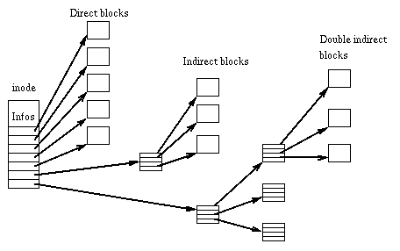
File Systems
I-Nodes – A control structure that points to data blocks or other i-nodes
  Fundamental building block of many file systems
  Limits on number of i-nodes
Blocks – A sequence of bytes on a media
  The smallest addressable storage unit
  A file can be saved across one or more blocks
  Large block sizes can waste disk space
  Grouped in to Block Groups
Superblocks – The first piece of info on a disk
  Contains key disk information
    Disk geometry, available space, first i-node location
  Multiple copies of the superblock,
  kept within each block group

Slide 67
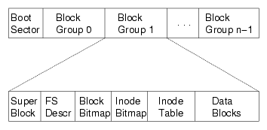
File Systems
File System – Provides a means of organizing data on a storage medium
  Abstraction layer above physical sectors, cylinders, circuits, etc.
  Extended File System 3 (EXT3)
    Widely used file system
    Journaling
  Extended File System 4 (EXT4)
    Enhancements to EXT3
    Extents can describe a group of blocks, instead of each block
    Online defragmentation
    Larger file systems and file sizes
  XFS
    Standard on RHEL7/CentOS7 Servers
  Btrfs (B-Tree FS)
    Butter FS
  NTFS, FAT32, more…
Notes:
Journaling file systems create an entry in a journal, before making a change to a disk, allowing for the ability to validate tasks were completed

Slide 68

File Systems
File system manipulation
  Mount and unmount file systems with the mount and umount commands
  Edit file system mounting properties in the /etc/fstab file
    Specifies disk path, mount point, mount options, etc.
  List open files with the lsof command
    Find files open on a filesystem by piping the output from lsof to grep and searching for desired location
    Ex: lsof | grep /home
  Check a filesystem with the fsck tool
    Doesn’t work on XFS! Use xfs_repair to replay journal (automatic on mount)
  The Lost+Found directory contains lost files…
    File fragments, directories, special files
    Lost i-node links or missing extent descriptions
    Unique per file system
    In general, if you have data here, you have data loss.

Slide 69
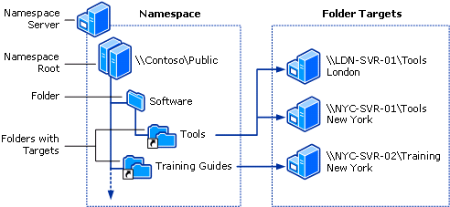
Distributed File Systems (DFS)
A Distributed File System makes it possible to create a single directory tree that links together multiple file servers and their files
Provides a common view of a centralized file system that is distributed among various servers
  Even though files are stored on different servers, to the user they appear on the same server
  Allows for replication among DFS servers
  Allows for the movement of files physical
  storage location without affecting any
  user or application usage
  System can be reconfigured as needed
  to alleviate performance issues
  System can be easily expanded if necessary,
  without any impact to existing users

Slide 70
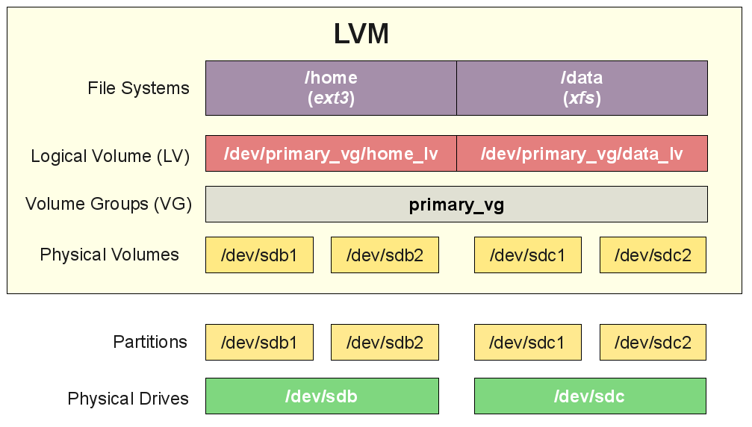
File Systems
Typical Linux Volume Management – Logical Volume Management (LVM)
  Disks are partitioned into physical volumes
    Each disk can be split into one or more partitions
    Each partition can be made in to a physical volume
    fdisk creates partitions, pvcreate to create physical volumes
  Physical volumes are grouped into volume groups
    Multiple volumes grouped together into one large storage group
    New volumes can be added to volume groups on the fly
    Volume groups created with vgcreate
  Volume groups are divided into logical volumes
    Logical volumes can stripe across multiple physical volumes,
    increasing throughput across multiple disks
    Logical volumes can be grown without service interruption
    Logical volumes created with lvcreate
  Logical volumes can be formatted to file systems
    mkfs command (ext2/3/4, xfs, btrfs, etc.)

Slide 71

Threats and Vulnerabilities
Hacker
  Someone who seeks and exploits weaknesses in a computer system or computer network.
  May be motivated by profit, protest, challenge, enjoyment, or employment.
  Various types of hackers
    Black/white/grey hat
    Elite
    Script Kiddie
Cracker
  Someone who uses cracking software to recover passwords or modify programs
  Crack various types of security on PC games
Attacker
  Generic term for anyone involved in nefarious activity

Slide 72
Threats and Vulnerabilities
Attacks can come from various locations/vectors
  Network Attacks
    Interrupt network services, preventing users from transmitting data
    Intercept insecure network traffic
    Alter traffic flow to sites
  Operating System Attacks
    Exploit vulnerabilities in the operating system itself
  Software Attacks
    Exploit specific software, may cross multiple platforms
  Social Engineering
    Manipulate people to divulge information
    Some people are gullible, easy to trick
    Phishing, diversion, pretexting, baiting, quid pro quo
    Humans are typically the weak part of any system…

Slide 73

Network Security
TCP/IP networks originally designed for communication, not security!
Hackers can take advantage of communication standards
Information can be intercepted, altered, and passed on to clients
Packet headers often targeted
  Source address
  Destination address
  Packet ID, flags, offset
  Length
  Protocol information

Slide 74
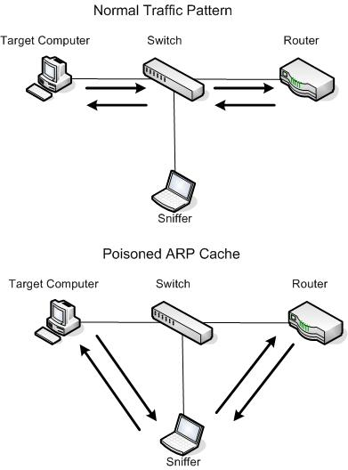
Network Security
ARP Spoofing – Man in the Middle attack
  ARP Cache Poisoning
  ARP associates IP addresses and MAC addresses
  on a layer 2 (switched) network
  Must be on the same network subnet as the target/victim
  Devices using ARP are inherently insecure
    They will accept updates at any time, no security checks
  Impersonate the network gateway device
  Victim passes all traffic through you, you then forward to gateway
  Gateway forwards all traffic for victim through you
    You intercept all data communications between target and gateway
    You can now easily inspect any unencrypted packets

Slide 75
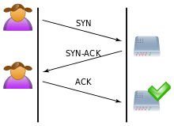
Network Security
TCP Three-Way Handshake
Typical network connection
  User sends SYN request to server, requesting a connection
  Server responds with SYN-ACK, acknowledging the connection request
  Client responds with ACK, acknowledging the request and establishing the connection

Slide 76
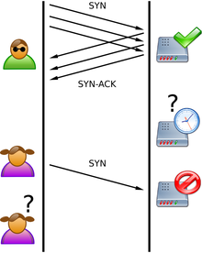
Network Security
SYN Flood
  A type of Denial of Service (DoS) attack
  Attacker sends multiple SYN requests to server, pretending to request a number of connections
    Requests may be forged, directing replies to various unsuspecting locations
      Reflected or spoofed attack
    Requests may come from different sources, making the attack distributed
  Server responds with multiple SYN-ACK’s, acknowledging the number of connection requests
  Acknowledgements are never returned, leaving the connections in a half-open state, preventing new connections from occurring
  Legitimate clients are unable to make connections, since all available connections are stuck in a half-open state
  Various countermeasures can be used

Slide 77
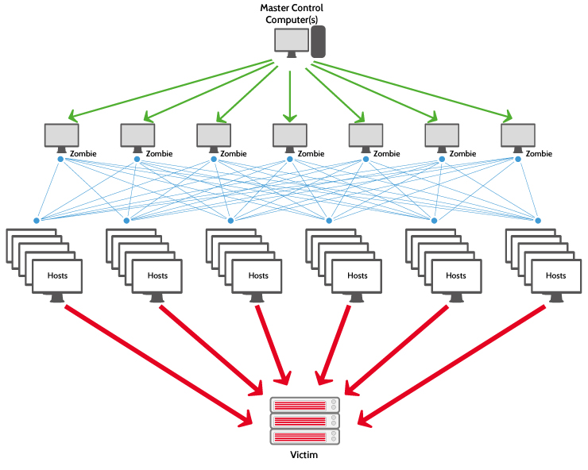
Network Security
Denial of Service Attack (DoS)
  Attempt to make resource unavailable due to overwhelming concurrent connections
  Using multiple sources creates a distributed denial of service attack (DDoS)
  Symptoms include slow or unavailable network resources
  Incorrectly configured network equipment can propagate certain types of attacks
  Attacks may be designed to crash services or overwhelm (flood) services
  Most involve IP address spoofing, disguising the actual source locations
Notes:
Mirai (Japanese for "the future", 未来) is malware that turns networked devices running out of date versions of Linux into remotely controlled "bots", that can be used as part of a botnet in large-scale network attacks. It primarily targets online consumer devices such as remote cameras and home routers. - Wikipedia

Slide 78
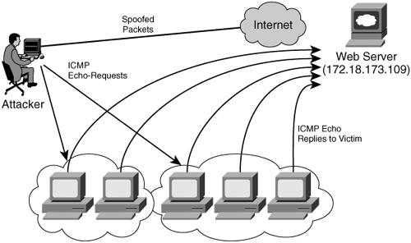
Network Security
Amplification and Reflection Attacks
  Use a small amount of traffic to create a larger response
  Attacker spoofs source address, perform relatively small network bandwidth sized action
  Response from affected systems are directed to spoofed source address (target)
  Bandwidth used by response is larger than initial query
  Source of attack is “reflected” off of responding server
  NTP, DNS, CharGen
Teardrop attacks
  Can crash various operating systems
  Attacks flaw in underlying TCP/IP code
Caller ID Spoofing

Slide 79
Network Security
Internet Control Message Protocol (ICMP) flood
  Also called smurf attack
  Uses incorrectly configured network devices to broadcast packets across the network
  Spoofed source address causes all traffic to incorrectly respond to target
Ping flood
  Overwhelm user with more ping request traffic than they can handle
  Simple attack, only requiring more network bandwidth than the target
Ping of Death, Nuke
  Crash system with malformed packets

Slide 80

Network Security
Advanced Persistent DoS (APDoS)
  Large scale attacks using commercial equipment
  Can simultaneously use multiple coordinated attack vectors
    HTTP floods, injection attacks, syn floods, etc
  Can affect multiple layers
    Interfering with the associated networking equipment
    can affect other uses of that equipment
  Typically explicit motivitation
    Nation-State warfare
    Large financial gain

Slide 81
Nmap – The Network Mapper
Features
  Scan IP address ranges
  Scan and ID port ranges
  Perform OS fingerprinting
  Scriptable interactions with target (NSE)
  Organization Unique Identifier Information (OUI)
Use Cases
  Network auditing
  Inventory mapping
  Network response analysis
  Identifying and abusing exploits
  Connection and communication testing

Slide 82
Nmap – The Network Mapper
Install Nmap
  dnf install nmap -y
Do some sample scans
  nmap 147.64.32.6
    Perform a basic/default scan on commonly used ports
  nmap -sn 147.64.242.100
    Perform a ping scan (no port scan) – used to identify if a host responds
    Can be customized to use traceroute or Nmap Scripting Engine (NSE)
  nmap -p 1-1024 147.64.242.101
    Scan TCP ports 1-1024
  nmap -O 147.64.32.242
    Perform OS fingerprinting; try to determine the guest OS!
    Capital oh!
man nmap !

Slide 83
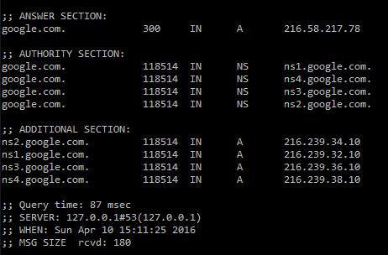
DNS Security
DNS Cache Poisoning
  Injecting incorrect DNS data into a servers DNS cache
  Causes DNS lookups to return incorrect address
  Exploits flaws in DNS software
  Provide incorrect authority information
    If asked who provides service for a domain, return incorrect info
    Redirect nameserver to attackers compromised nameserver
    Incorrect NS Records
  Provide incorrect additional information
    Return incorrect “helper” information
    Incorrect “Additional section” in DIG command
  Use of Secure DNS (DNSSEC) records to mitigate risks
    Cryptographic digital signatures with trusted public key certificates

Slide 84

Operating System Security
OS’s are large and complex pieces of software
  Potential for many bugs in such complex software
  Opportunity for many different types of vulnerabilities
Unpatched systems can offer easy attack vectors
  Patched vulnerabilities are often public
  Known attacks may exist against specific unpatched software
Buffer overflows can cause systems to crash
  Write data outside of a buffer’s allowed memory
Attacks to specific software
  Exploit vulnerabilities in non-OS software
  Applications running as root/administrator especially attractive

Slide 85
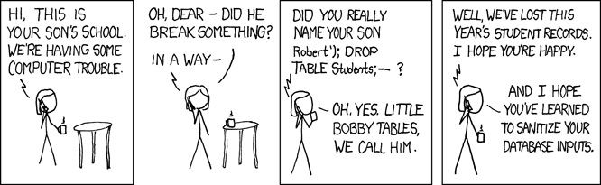
Web Server Vulnerabilities
PHP/ASP/etc. programming vulnerabilities
  Potential for bugs in code that runs server or on clients machine
Web server software vulnerabilities
  Opportunity for exploits of Apache/IIS/etc. software
Database attack vulnerabilities
  Potential to attack database through incorrect programming
Unencrypted communication
  Clear-text passwords
  Sensitive information

Slide 86

E-Mail Server Vulnerabilities
Plain text authentication
Spam
Ease of address spoofing
  Fake where email appears to come from
Open internet forwarders
  Allow for easy anonymous email transmission
DoS Attacks, E-Mail Bombs
  Overwhelm email services with illegitimate email messages
Virus
  Propagate nefarious applications throughout the world

Slide 87
SMTP Commands and processes
Sample SMTP Session:
[jpatalon@csci325-120 ~]$ telnet spamblock.edinboro.edu 25
Trying 147.64.32.99...
Connected to spamblock.edinboro.edu.
Escape character is '^]'.
220 barracuda.edinboro.edu ESMTP (8908a72cdf255605894d2e1a03ee284e)
HELO megastuff.biz
250 barracuda.edinboro.edu Hello csci325-125. cs.edinboro.edu [147.64.243.125], pleased to meet you
MAIL FROM: <jpatalon@megastuff.biz>
250 Sender <jpatalon@megastuff.biz> OK
RCPT TO: <jpatalon@edinboro.edu>
250 Recipient <jpatalon@edinboro.edu> OK
DATA
354 Start mail input; end with <CRLF>.<CRLF>
From: bob@megastuff.biz
To: junk@edinboro.edu
Subject: test email
This is a test.
.
250 Ok: queued as EFB4511EE001
quit
221 barracuda.edinboro.edu Goodbye csci325-125. cs.edinboro.edu, closing connection

Slide 88
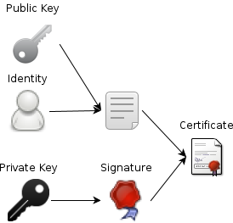
Securing Network Services
Encrypt transmitted data
  SSH, SCP, SFTP
  HTTPS/SSL
  Encrypted WiFi
Establish trusted authorities
  Certificate Authorities (CA) verify certificate holders
Create methods of establishing secure connections
  Public Key Cryptography
  Diffie-Hellman Key Exchange
  https://www.youtube.com/watch?v=YEBfamv-_do
    8 minutes 37 seconds

Slide 89
Certificate Authority
A Certificate Authority (CA) issues digital certificates
  SSL Certificates for use on our websites
Devices (browsers) come with a list of trusted third-party CA’s
  Because they are more trustworthy than me…
CA’s certify the ownership of the certificate
  CA’s validate the legitimacy of the person or organization
  CA’s can also revoke a certificate, if it has been compromised
When we create our own certificates, they are self-signed.
  Our browser doesn’t automatically accept it, but we can manually override
  We could potentially create our own CA, add it to the trusted list of our
  servers/clients, and issue our own trusted certificates, to encrypt network traffic

Slide 90

Secure Sockets Layer (SSL)
Digital certificate’s issued by a Certificate Authority (CA)
  Identifies an organization
  CA most often a third party (e-commerce)
Public Key Infrastructure (PKI)
  Defines the system of certificates and authorities
Public key cryptography depends on two keys
  Public key
    Shared with everyone
    Used to encrypt data to sent to a server
    Client encrypts session key (clients private key) with message
  Private key – kept by owner of the public key
    needed to decrypt the data

Slide 91
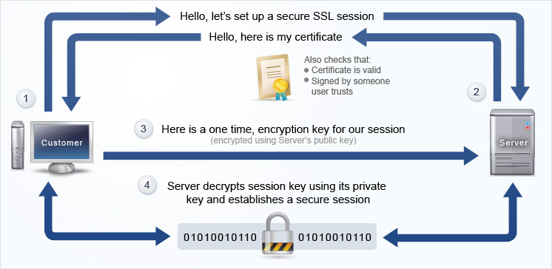
Establish HTTPS Session – Session Key

Slide 92
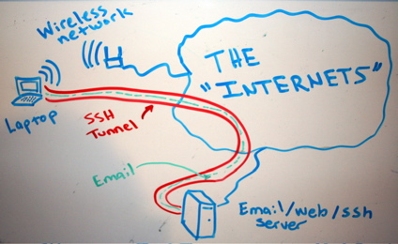
SSH Tunnels
SSH Tunnels are secure and encrypted between endpoints!
  Unencrypted (or encrypted) traffic can be routed through encrypted SSH connection
Local Port Forwarding
  Good for specific services (RDP, POP3, etc)
SOCKS (Dynamic) Proxy
  Good for web traffic
Reverse SSH Tunnel
  Initiate connection from inside secure location
  Provide access otherwise not possible

Slide 93

System Security – Best Practices
Only give users the necessary account privileges
  Performing routine tasks as a root/admin user can create vulnerabilities!
Only install necessary software for server operation on servers
  Most servers don’t need Adobe Flash or spreadsheet software
Review all services running on a server
  Disable unnecessary services
  Secure any necessary services
    Disable open email forwarding or DNS resolution
Enforce auditing where appropriate
  Keep logs of user actions and connections
  Make use of remote logging facilities

Slide 94
System Security – Best Practices
Regularly audit running services and file permissions
Perform vulnerability or penetration testing on your own systems
  Find any issues before attackers can
Disable insecure services
  Replace with more secure software
  May be hard in large organizations with legacy systems
Use secure/encrypted version of services
  HTTP → HTTPS
  Telnet → SSH
  FTP → SCP
  Force secure POP3/IMAP type services

Slide 95
System Security – Best Practices
System Configuration
  Limit disk space one user or application can use
    Impose storage quotas, separate disk partitions
  Limit CPU/RAM resources one user or application can use
  Limit data that a user or application can access
  Disable unnecessary features
  Enforce user and group security
  Disable world/anonymous/everybody access
    Only where appropriate!
    Many built-in functions may rely on such access!
  Secure web directories
    Web folders should only be readable by web services
    Potentially only allow users from specific IP address, or deny specific IP addresses
  Implement username/password login where appropriate

Slide 96

One-Way Hash
A One-Way Hash is a function that takes a variable length input string, and returns a fixed length output string
  Two input strings should not be able to produce the same output hash
  Process should be difficult to reverse
  A minor change in input should create significant change in output
  Sometimes called message digest or fingerprint
Examples:
  MD4 & MD5 (Message Digest)
    128-bit hash values
  SHA (Secure Hash Algorithm)
    160-bit hash values; generally accepted algorithm
  SHA256/512
    256/512-bit hash values

Slide 97
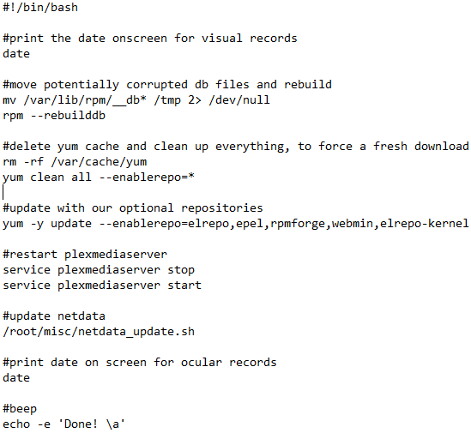
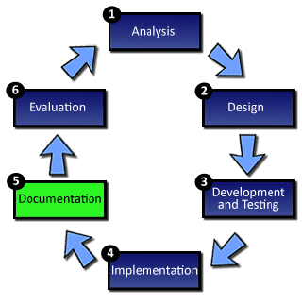
Documentation
Make things easily repeatable
Use commands and comments to make an actual script!
Test things
Automate testing?!
Example →

Slide 98

System Life Cycle
A method of breaking down the development of a new system into a logical set of stages, each of which are involved with specific tasks.
The SLC consists of the following stages:
  Definition
  Investigation and analysis
  Design
  Implementation
  Testing
  Installation
  Documentation
  Evaluation
  Maintenance
Notes:
http://www.teach-ict.com/as_as_computing/ocr/H047/F451/312/slc_cycle/miniweb/index.htm

Slide 99

Assignment 11 Checklist
AWStats should be installed and have:
  Config file at /etc/httpd/conf.d/awstats.conf
  Crontab entry for root user
  Responds to webpage requests
Read assignment 11 and run assignment 11 check script
  https://jpatalon.cs.edinboro.edu/ecsc325/Assignment%2011.pdf
  https://jpatalon.cs.edinboro.edu/ecsc325/classfiles/assignment11check.sh
  Don’t forget to set script executable before running!
  Documentation!
Parts of this assignment - 45 Points
  AWStats configs
  Backups of web files and WordPress database
  MariaDB configuration optimization updates
  System updates and reboot!
Info for assignment on last weeks slides!

Slide 100
Assignment 12 Checklist
Add a new network interface (enp9s0) with an additional VIP
Add VLAN 66 on the new network interface (enp9s0.66)
Create a new data LV in our cs VM , ext3 FS, and mount it at /data
Create a NFS export of /data only available to the VLAN 66 network
Mount the professors private VLAN 66 NFS mount at /110.data
Read assignment 12 and run assignment 12 check script
  https://jpatalon.cs.edinboro.edu/ecsc325/Assignment%2012.pdf
  https://jpatalon.cs.edinboro.edu/ecsc325/classfiles/assignment12check.sh
  Don’t forget to set script executable before running!
  Documentation!
Info for assignment on last weeks slides!

Slide 101
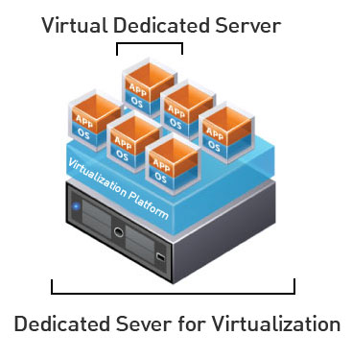
Virtual Machine Info
IP Address: 147.64.243.1##/23 (01-25)
Hostname: ecsc325-1##.cs.edinboro.edu (01-25)
Aliases:
  31##.megastuff.biz, 1##.megastuff.biz, ##.megastuff.biz (01-25)
  1##.ultrastuff.net, more?
Assignment 11 due April 2nd
  Check script and upload in D2L!
Assignment 12 due April 9th
  Check script and upload in D2L!
Accessing VM’s from off campus requires a connection to the CS VPN first,
before opening a connection to your machine!
  CS firewall prevents direct connections from other networks to our VM’s!
    Once VPN is active: ssh user@ecsc325-1##.cs.edinboro.edu

Slide 102
Virtual Hosts
http://ecsc325-1##.cs.edinboro.edu, http://147.64.243.1##
  PHP Info
http://ecsc325-1##.cs.edinboro.edu/phpmyadmin, http://147.64.243.1##/phpmyadmin
  phyMyAdmin Website
http://1##.megastuff.biz/temp/temp.php
  Temperature Graph Website
http://31##.megastuff.biz
  index.html: Hello Megastuff Website
http://##.megastuff.biz, http://1##.megastuff.biz
  TBD: Testing 123…
http://ecsc325-110.cs.edinboro.edu/awstats/
awstats.pl?config=localhost.localdomain
  AWStats
http://ecsc325-1##.cs.Edinboro.edu/squirrelmail
  Squirrelmail website
http://roundcube.##.megastuff.biz
  Roundcube webmail
http://1##.ultrastuff.net
  Ultra Modern Template Website
http://31##.ultrastuff.net
  WordPress Website
https://ecsc325-1##.cs.edinboro.edu/private
  Private web site!
https://a14.##.megastuff.biz
  Assignment 14 web site!
Replace the ## with your 2 digit number!!!

Slide 103

Linux Commands
rsync
mysqldump
iptables
firewall-cmd
systemctl
yum
vi
nano

Slide 104

Key Terms and Items
Data Centers
Power Distribution Units
Cron/Crontab
Syslog/rsyslog
FirewallD
AWStats
Apache logging
RSync

Slide 105

For Next Week
Go confidently in the direction of your dreams. Live the life you have imagined.
  Henry David Thoreau
Textbook:
  Chapter 13: Netfilter Firewall
Next week topics
  Security & Authentication
Finish work with VM’s
  Assignment 11 due this week!
  Assignment 12 due next week!
  Just because all tests say OK, doesn’t mean everything is working properly!
    I can’t write check scripts for every possibility…

